Slide 1

SARCASM DETECTION IN TEXT USING MACHINE LEARNING AND TRANSFORMER MODELS
Comparative Analysis using MUStARD Dataset
Roll NO | Prn | Name | Batch
282037 | 22311046 | Sahil.C.Bhagwat | B2
282040 | 22311287 | Shivam Wangikar | B2
282042 | 22311296 | Gaurav Yadav | B2
282047 | 22311433 | Apurva Jangle | B2

Slide 2

Sr. No. | Title | Page No.
1 | Problem Statement and Abstract | 3
2 | Introduction | 4
3 | Solution Overview | 6
4 | Literature Survey | 7
5 | Methodology | 8
6 | Architecture and Flow Diagram | 9
7 | Tech Stack | 10
8 | EDA | 11
9 | Result | 12,13
10 | Uniqueness | 14
11 | conclusion, future scope, references | 15, 16

Slide 3
ABSTRACT
Dataset : MUStARD
Goal : Compare SVM (traditional) vs. Transformers (BERT/RoBERTa/XLNet) on MUStARD
Key Finding: RoBERTa (3-fold tuned) achieved 71.1% F1, outperforming SVM (64% F1)
Challenge of Sarcasm Detection
Sarcasm, especially in conversational settings, is hard to detect due to its
reliance on subtle context and tone.
RoBERTa with Tuning + Features Outperforms
Fine-tuned RoBERTa with contextual, linguistic, and sentiment-based features
Achieved the best F1-score (71.1%), outperforming all other models.
SVM Shows High Precision, Low Recall
While SVM demonstrated high precision, it struggled with recall due to lack of
contextual understanding and limited feature extraction.

Slide 4

INTODUCTION
Wow! Kitna helpful hai ye customer service. Sawaal pucho, jawab 2 mahine baad milta hai.
What is Sarcasm ?
Sarcasm is a form of expression where the intended meaning is often opposite to the literal words spoken, making it hard for machines to interpret.
Waise bhi India mein toh sab corruption-free hai.
Project explores how well machines can recognize sarcasm in conversations using data-driven approaches.
Detecting sarcasm in text is crucial for improving the accuracy of :
-sentiment analysis
-understanding user intent in social media
-dialogue systems.
The rise of conversational AI and digital communication has made it increasingly important to build models that can detect nuanced language like sarcasm.
Wah! Government office ka kaam toh lightning speed mein hota hai!”

Slide 5
EXISTING METHODS
Rule-Based Approaches
Based on sarcasm indicators like punctuation (e.g., “Yeah, right!”), interjections, or contrast between positive and negative words.
Low accuracy due to lack of context understanding.
Transformer-Based Models (Recent Advances)
Pretrained models like BERT, RoBERTa, XLNet
Understand context using self-attention mechanisms
State-of-the-art performance in sarcasm and sentiment tasks
Can be fine-tuned for sarcasm classification with smaller labeled data
Classical Machine Learning Models
Algorithms: SVM, Random Forest, Logistic Regression
Features: TF-IDF, POS tags, N-grams, sentiment scores
Drawback: Cannot capture deeper semantic meaning or long-range dependencies.
Deep Learning Approaches
Models like LSTM, BiLSTM, GRU
Can model sequences and context better than ML models
Require large datasets for effective training

Slide 6
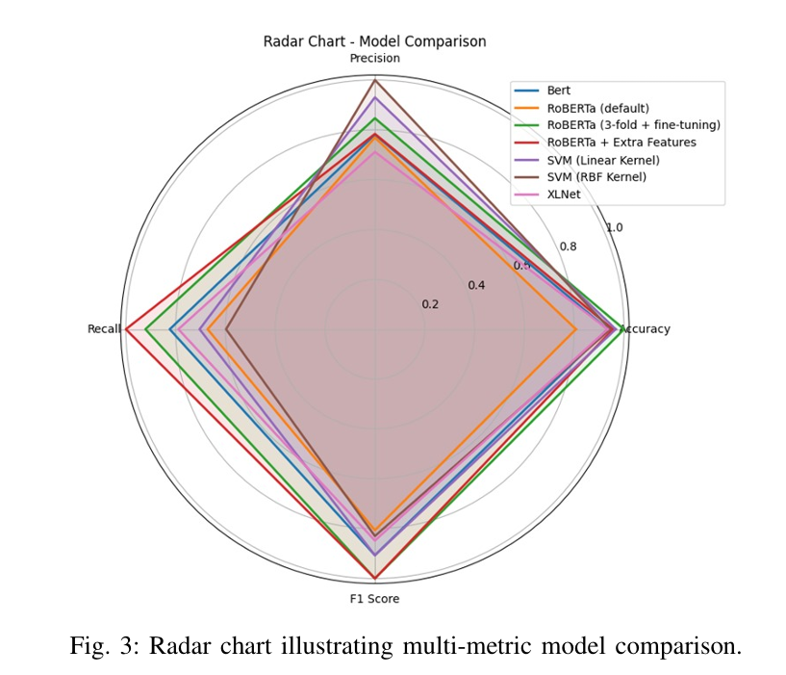
PROPOSED METHOD
Collected the MUStARD dataset focused on text-based sarcasm detection.
2. Performed data cleaning and preprocessing to prepare the text.
3. Applied TF-IDF vectorization for traditional models and used pretrained tokenizers for transformer-based models.
4. Implemented multiple models including SVM, BERT, RoBERTa,
RoBERTa with fine-tuning, RoBERTa with 3-Fold Cross Validation,
and XLNet.
5. Conducted training and testing using standard train-test split and cross-validation where applicable.
6. Evaluated models based on accuracy, precision, recall, and F1-score to compare performance.

Slide 7
LITERATURE SURVEY
Paper | Key Contribution | Methodology | Strengths | Limitations | Relevance to Project
[2] Devlin et al. (BERT, 2019) | Introduced BERT: Bidirectional Transformer for NLP. | Masked LM + Next Sentence Prediction. | Contextual embeddings, SOTA on GLUE. | Computationally heavy; needs fine-tuning. | Baseline for our Transformer comparison.
[3] Liu et al. (RoBERTa, 2019) | Optimized BERT with dynamic masking + larger batches. | Modified pretraining (no NSP, longer sequences). | Higher robustness than BERT. | Still lacks sarcasm-specific features. | our best-performing model (71.1% F1).
[6] Castro et al. (MUStARD, 2019) | Multimodal sarcasm dataset (TV shows). | Text + audio + video annotations. | Rich conversational context. | Small size (690 samples). | our core dataset (text-only subset).
[12] Ghosh & Muresan (2018) | Context-aware sarcasm detection. | BERT + conversational context. | Improved recall with context. | Limited to social media data. | Supports your RoBERTa context embeddings.

Slide 8
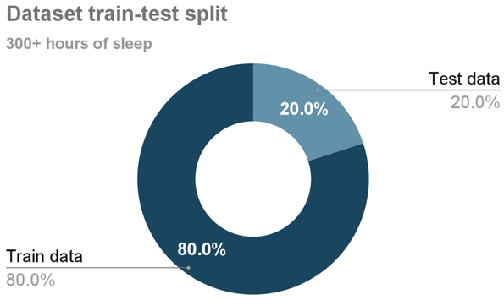

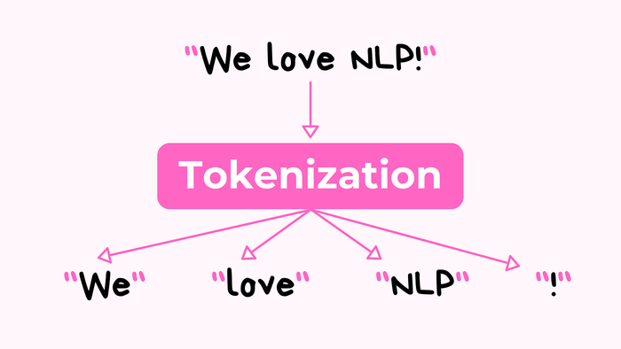
METHODOLOGY
We started with the MUStARD dataset, which contains text samples
labeled for sarcasm.
The data was preprocessed to clean and standardize the text.
For traditional models like SVM, we used TF-IDF for feature extraction.
For deep learning, we implemented transformer-based models like BERT, RoBERTa (standard, fine-tuned, and with 3-Fold Cross Validation), and XLNet using pretrained tokenizers.
Each model was trained and tested, and their performance was evaluated using accuracy, precision, recall, and F1-score to compare effectiveness.

Slide 9
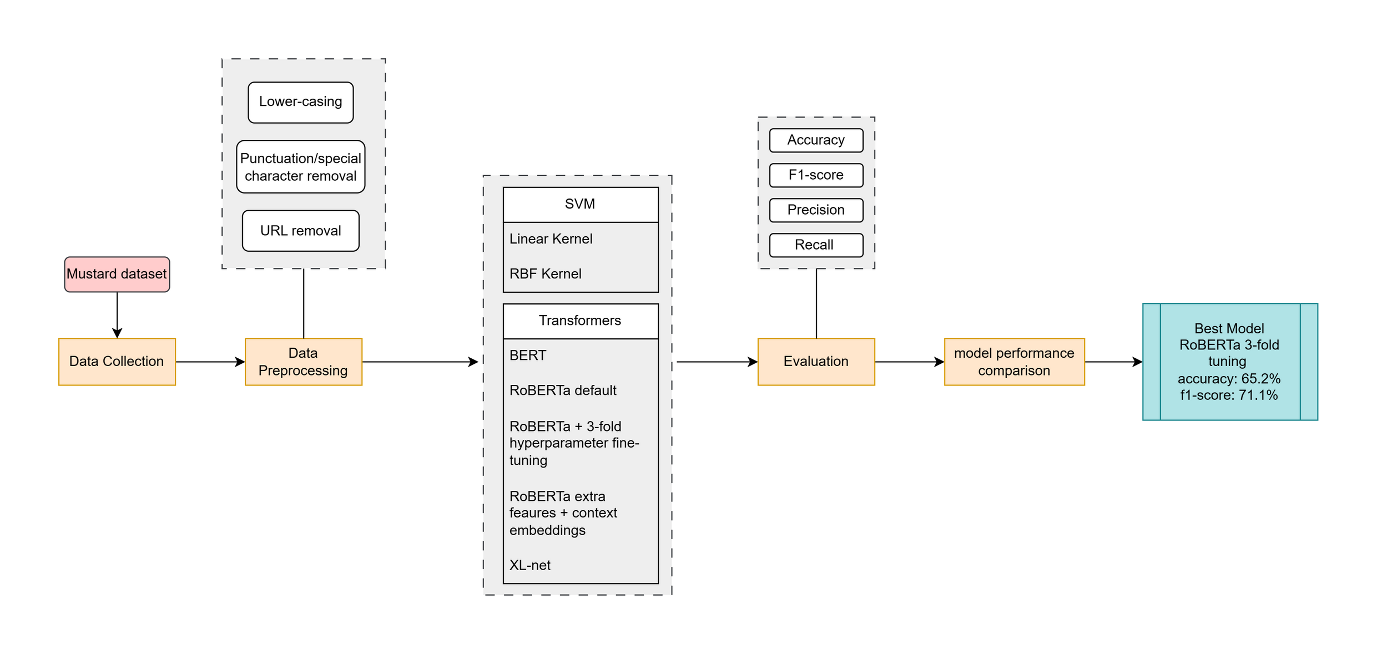
ARCHITECTURE

Slide 10
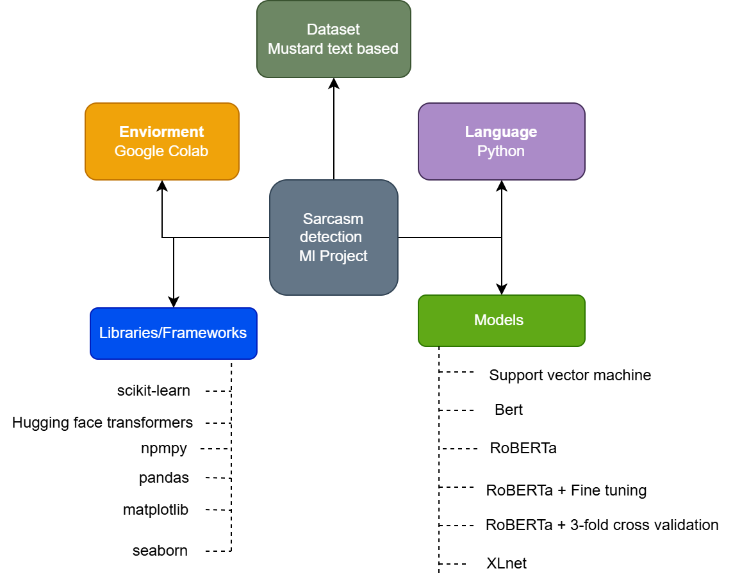
INPLEMENTATION DETAILS/TECH STACK
Programming Language: Python
Environment: Google Colab
Libraries & Frameworks:
scikit-learn
Hugging Face Transformers
NumPy, Pandas
Matplotlib / Seaborn (for visualizations)
Models Used:
Support Vector Machine (SVM)
BERT
RoBERTa
RoBERTa + Fine-Tuning
RoBERTa + 3-Fold Cross Validation
XLNet
Dataset: MUStARD (Multimodal Sarcasm Detection Dataset)

Slide 11
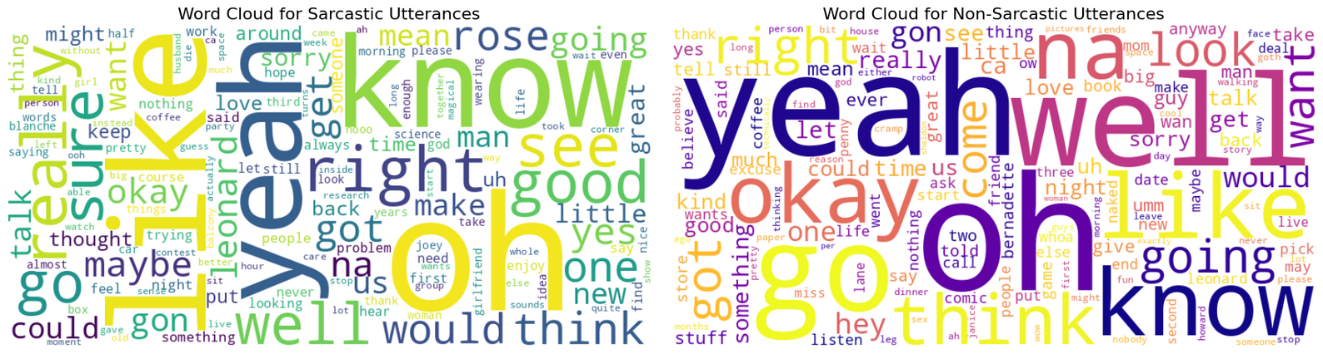
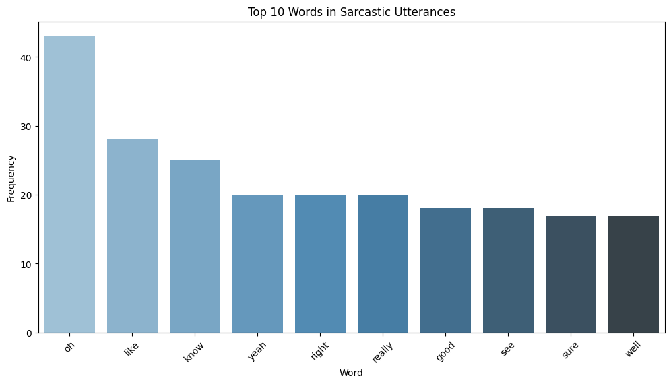
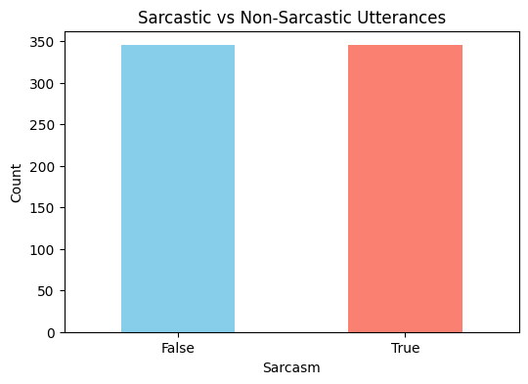
EDA

Slide 12
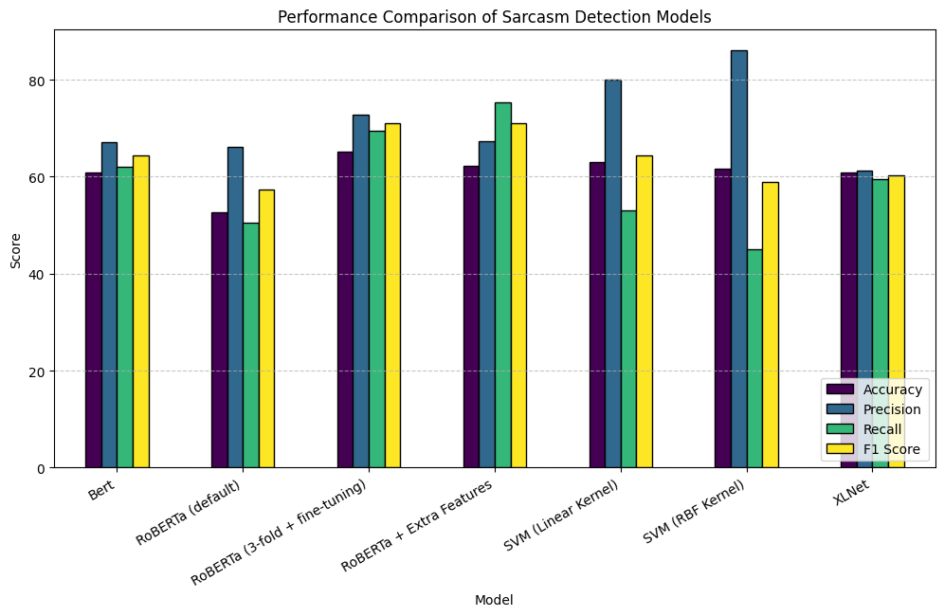
RESULT
We show
that traditional SVM methods do not outperform Transformer
models well-tuned or augmented with relevant features for
this conversational sarcasm task, and our findings indicate
that Transformer models perform much better than traditional
approaches in terms of F1 score for this conversational sarcasm
task.

Slide 13
RESULT - MODEL COMPARISON
Model | Acccuracy | Precision | Recall | F1-Score | Note
Roberta | 53.6% | 66.15% | 50.59% | 57.33% | Baseline transformer, performance is low
RoBERTa + 3-Fold + Hyperparameter Finetuning | avg: 59.7% final: 65.2% | 72.8% | 69.4 | avg: 60.8% final: 71.1% | The fine tuned model improved overall, expecially f1
RoBERTa + Extra Features & Context Embedding | 62.3% | 67.4% | 75.3% | 71.1% | Adding extra features helped boost recall and f1
BERT | 60.9% | 67.12% | 62.03% | 64.47% | Slightly better than baseline roberta
SVM (Linear Kernel) | 63.0% | 80% | 53% | 64.0% | Lightweight Model: competitive with transformers.
SVM (RBF Kernel) | 61.6% | 86% | 45% | 59.0% | Similar to linear SVM, with a bit lower F1.
XLNet | 60.9% | 61.19% | 59.42% | 60.29% | Shows balanced but modest performance.

Slide 14
UNIQUE CONTRIBUTION IN PROJECT
1.Comprehensive Model Comparison
2.Custom Fine-Tuning Strategies
3.Benchmarking on Real-world Dataset
4.Insightful Observations
5.Multi-Metric Evaluation

Slide 15

Conclusion
-Transformer models perform much better than traditional
approaches in terms of F1 score for this conversational sarcasm
task.
- It is found that with 3 – fold cross validation and parameter
optimization of the hyper parameters, the RoBERTa Model
fine-tuned has the highest F1 - score (71.1%) and accuracy
(65.2%).
Future Scope
Multimodal Integration
Multilingual Sarcasm Detection
Larger and Diverse Datasets
Cross-Domain Adaptation

Slide 16
REFERENCES
[1] R. Pang, L. Lee, and S. Vaithyanathan, ”Thumbs up?: sentiment classi f ication using machine learning techniques,” in Proceedings of the ACL 02 conference on Empirical methods in natural lan- guage processing Volume 10, 2002, pp. 79-86.
[2] J. Devlin, M. W. Chang, K. Lee, and K. Toutanova, ”BERT: Pre-training of Deep Bidirectional Transformers for Language Understanding,” in Proc. NAACL-HLT, 2019, pp. 4171-4186.
[3] Y. Liu, M. Ott, N. Goyal, J. Du, M. Joshi, D. Chen, O. Levy, M. Lewis, L. Zettlemoyer, and V. Stoyanov, ”RoBERTa: A Ro- bustly Optimized BERT Pretraining Approach,” arXiv preprint arXiv:1907.11692, 2019.
[4] Z. Yang, Z. Dai, Y. Yang, J. Carbonell, R. Salakhutdinov, and Q. V. Le, ”XLNet: Generalized Autoregressive Pretraining for Language Understanding,” in Advances in Neural Information Processing Systems (NeurIPS), 2019, vol. 32
[5] C. Cortes and V. Vapnik, ”Support-vector networks,” Machine learning, vol. 20, no. 3, pp. 273-297, 1995.
[6] S. Castro, D. Hazarika, V. Pe´rez-Rosas, R. Mihalcea, and S. Poria, ”MUStARD: A Multimodal Sarcasm Detection Dataset,” in Proc. ACL, 2019, pp. 2409-2419.
[7] T. Wolf et al., ”Transformers: State-of-the-Art Natural Language Pro cessing,” in Proc. EMNLP (Systems Demonstrations), 2020, pp. 38-45.
[8] F. Pedregosa et al., ”Scikit-learn: Machine Learning in Python,” Journal of Machine Learning Research, vol. 12, pp. 2825-2830, 2011.
[9] E. Riloff, A. Qadir, P. Surve, L. De Silva, N. Gilbert, and R. Huang, ”Sarcasm as contrast between a positive sentiment and negative situa tion,” in Proc. EMNLP, 2013, pp. 704-714.
[10] D. Davidov, O. Tsur, and A. Rappoport, ”Semi-supervised recog- nition of sarcastic sentences in Twitter and Amazon,” in Proc. CoNLL, 2010, pp. 107-116.
[11] S. Poria, E. Cambria, D. Hazarika, and P. Vij, ”A Deeper Look into Sarcastic Tweets Using Deep Convolutional Neural Networks,” in Proc. COLING, 2016, pp. 2700-2710.
[12] D. Ghosh and W. Muresan, ”Sarcasm Analysis using Conversation Context,” Computational Linguistics, vol. 44, no. 4, pp. 755-792, 2018. [13] I. Potamias, K. Siolas, and A. Stafylopatis, ”Transformer-based Context aware Sarcasm Detection in Conversation Threads from Social Media,” in Proc. EACL, 2021, pp. 59-69.
[14] D. Hazarika, R. Zimmermann, and S. Poria, ”MISA: Modality- invariant and-specific representations for multimodal sentiment analysis,” in Proc. ACM Multimedia, 2020, pp. 1122-1131.
[15] S. Bird, E. Klein, and E. Loper, Natural Language Processing with Python: Analyzing Text with the Natural Language Toolkit. O’Reilly Media, Inc., 2009.
[1] R. Pang, L. Lee, and S. Vaithyanathan, ”Thumbs up?: sentiment classi f ication using machine learning techniques,” in Proceedings of the ACL 02 conference on Empirical methods in natural lan- guage processing Volume 10, 2002, pp. 79-86.
[2] J. Devlin, M. W. Chang, K. Lee, and K. Toutanova, ”BERT: Pre-training of Deep Bidirectional Transformers for Language Understanding,” in Proc. NAACL-HLT, 2019, pp. 4171-4186.
[3] Y. Liu, M. Ott, N. Goyal, J. Du, M. Joshi, D. Chen, O. Levy, M. Lewis, L. Zettlemoyer, and V. Stoyanov, ”RoBERTa: A Ro- bustly Optimized BERT Pretraining Approach,” arXiv preprint arXiv:1907.11692, 2019.
[4] Z. Yang, Z. Dai, Y. Yang, J. Carbonell, R. Salakhutdinov, and Q. V. Le, ”XLNet: Generalized Autoregressive Pretraining for Language Understanding,” in Advances in Neural Information Processing Systems (NeurIPS), 2019, vol. 32
[5] C. Cortes and V. Vapnik, ”Support-vector networks,” Machine learning, vol. 20, no. 3, pp. 273-297, 1995.
[6] S. Castro, D. Hazarika, V. Pe´rez-Rosas, R. Mihalcea, and S. Poria, ”MUStARD: A Multimodal Sarcasm Detection Dataset,” in Proc. ACL, 2019, pp. 2409-2419.
[7] T. Wolf et al., ”Transformers: State-of-the-Art Natural Language Pro cessing,” in Proc. EMNLP (Systems Demonstrations), 2020, pp. 38-45.
[8] F. Pedregosa et al., ”Scikit-learn: Machine Learning in Python,” Journal of Machine Learning Research, vol. 12, pp. 2825-2830, 2011.
[9] E. Riloff, A. Qadir, P. Surve, L. De Silva, N. Gilbert, and R. Huang, ”Sarcasm as contrast between a positive sentiment and negative situa tion,” in Proc. EMNLP, 2013, pp. 704-714.
[10] D. Davidov, O. Tsur, and A. Rappoport, ”Semi-supervised recog- nition of sarcastic sentences in Twitter and Amazon,” in Proc. CoNLL, 2010, pp. 107-116.
[11] S. Poria, E. Cambria, D. Hazarika, and P. Vij, ”A Deeper Look into Sarcastic Tweets Using Deep Convolutional Neural Networks,” in Proc. COLING, 2016, pp. 2700-2710.
[12] D. Ghosh and W. Muresan, ”Sarcasm Analysis using Conversation Context,” Computational Linguistics, vol. 44, no. 4, pp. 755-792, 2018. [13] I. Potamias, K. Siolas, and A. Stafylopatis, ”Transformer-based Context aware Sarcasm Detection in Conversation Threads from Social Media,” in Proc. EACL, 2021, pp. 59-69.
[14] D. Hazarika, R. Zimmermann, and S. Poria, ”MISA: Modality- invariant and-specific representations for multimodal sentiment analysis,” in Proc. ACM Multimedia, 2020, pp. 1122-1131.
[15] S. Bird, E. Klein, and E. Loper, Natural Language Processing with Python: Analyzing Text with the Natural Language Toolkit. O’Reilly Media, Inc., 2009.

Slide 17
THANK YOU
Github repo : https://github.com/Sahil242004/ML_PROJECT_SEM4

